Slide 1
Get Better Fast: CCD

Slide 2
Big Picture: What is a CCD?
CCD stands for “charge coupled device”
Integrated circuit on a silicon semiconductor surface creates light-sensitive elements known as “pixels”
Photons strike this surface, which creates electrical charge which can be interpreted and displayed as a digital representation by some electronic device

Slide 3
Background
CCD concept was invented in 1969 by Willard Boyle and George Smith while working at AT&T Bell Labs
First functional prototype was a simple 8-bit shift register used as an eight pixel linear imaging device
Jointly received Nobel Prize for Physics in 2009 for their invention

Slide 4
Structure
CCDs have two main regions
Photoactive region
Transmission region
Photoactive region: The light-sensitive silicon layer
Created using epitaxy
Transmission region: The area where the electrons are captured and moved
Created using shift register

Slide 5
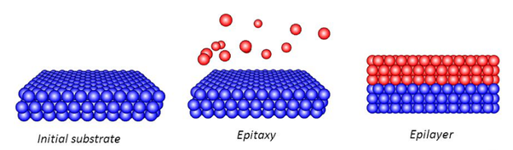
Epitaxy
Epitaxy is when a crystalline overlayer is deposited on top of some kind of crystalline substrate,
Generally with the intent to have matching atomic structures
The overlayer is also called the epitaxial film/layer
Homoepitaxy: film and the substrate are the same composition; otherwise it is called heteroepitaxy

Slide 6
Epitaxy II
Many different methods: vapor phase, molecular beam, liquid phase, solid phase, chemical vapor deposition, atomic layer, etc.
For epitaxial silicon, which is the overlayer used in CCDs, vapor phase epitaxy is typically used
SiCl_{4(g)} + 2H_{2(g)} ↔ Si_{(s)} + 4HCl_{(g)}

Slide 7
Structure II
The epitaxial silicon overlayer is p doped
The underlying substrate is typically p++
Buried channel vs surface channel
Buried: More common, less dark current, higher efficiency, smaller charge capacity
Gate oxide is placed on top of the overlayer
Gate electrodes are placed on top of the oxide

Slide 8
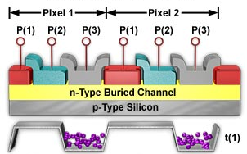
Structure III
Multiple gate electrodes combine to form a single CCD pixel
Can be two, three, four electrodes per pixel
Charge packets (purple) are stored in potential wells under gate mechanism

Slide 9
Structure IV
Each pixel is a MOS capacitor
When photons strike the silicon overlayer and the components on top of it, electrons are knocked out of place
Due to the photoelectric effect
Photoelectric effect: emission of (typically) electrons when photons strike a surface (typically a metal)

Slide 10
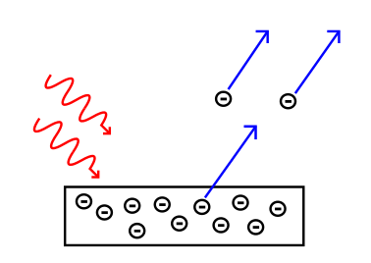
Photoelectric Effect
First discovered in 1887 by Heinrich Hertz when he noticed that sparks came out of metal occasionally when light was shone on it

Slide 11
Physics Predictions
If the incident light intensity increases, what will happen to the kinetic energy of the photoelectrons?
If the incident light intensity increases, what will happen to the rate of electron emission?
If the incident light frequency increases, what will happen to the kinetic energy of the photoelectrons?
If the incident light frequency increases, what will happen to the rate of electron emission?

Slide 12
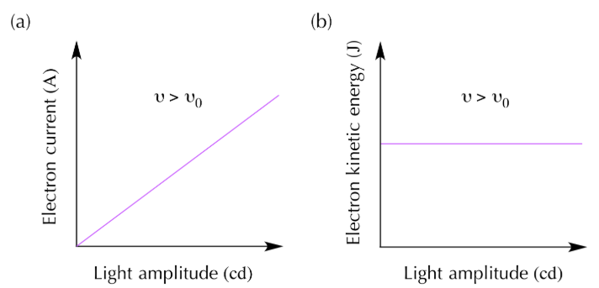
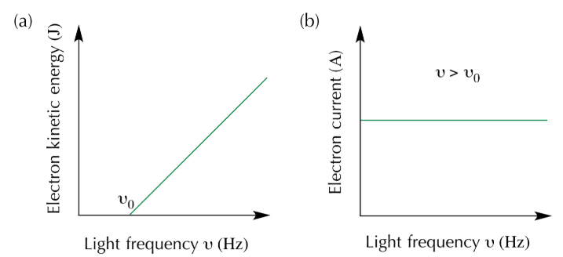

Slide 13
Pro Predictions
19th century scientists thought the photoelectric effect was caused by oscillating electric field of light waves heating up electrons until they vibrated enough to break free
Back then, light was thought to be purely a wave

Slide 14
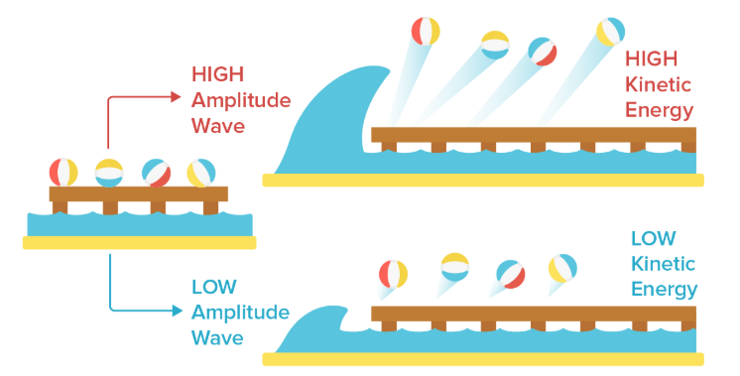
Photoelectric Wave Concept

Slide 15
Uh oh…
Experimental results failed to match up with theoretical models
Einstein proposes new model, saying that light can behave as discrete packets of electromagnetic energy
Known as photons
Energy of photon given by E = hf

Slide 16
Photoelectron Capture
The MOS capacitors are biased into the depletion region
Depletion region: Insulating space inside a doped semiconductor where mobile charge carriers have been forced away
The gate is biased at a positive potential, while the negative charges go into the potential well
Voltage drop is what makes the structure like a well, waiting to be filled by electrons
Depth of well is proportional to the voltage drop

Slide 17
Charge Transfer
Channel stops are basically barriers that are added to prevent the charges from separate columns from mixing
Channel stops are parallel to the columns
Polysilicon gates are added afterwards which are perpendicular to the channels

Slide 18
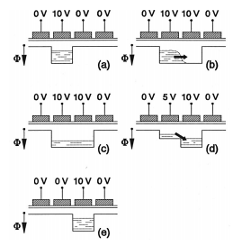
Charge Transfer II
How do the charges actually move?
Think of the potential wells in the MOS capacitors as buckets
To transfer the charge, pour a bucket into the adjacent bucket down the line by changing voltage

Slide 19
Charge Transfer III
Shift register: sequential logic circuit for storing and manipulating data
Several different methods to employ for a shift register
For simplicity, only going to describe Full frame CCD

Slide 20

Register Readout
Register has two main movements, vertical shift and horizontal shift
In the picture below, the “buckets” in (a) all undergo a vertical shift to produce (b)
Next, the readout register uses horizontal shift to read out the bottom-most row one by one

Slide 21
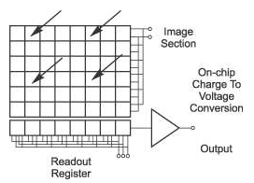
Register Readout II
As each bucket goes into the serial readout register, the current analog value (amount of electrons) must be converted into a digital value
A/D converter measures the voltage created by the electrons

Slide 22
Register Readout III
A/D converter has output in units called “analog to digital units”, or ADU
A/D electronics have inherent upper limit on range of numbers it can represent (system bit-size)
CCDs can hold hundreds of thousands of electrons, which is more than ADU upper limit
To access the full dynamic range of a pixel, different gain settings must be incorporated

Slide 23
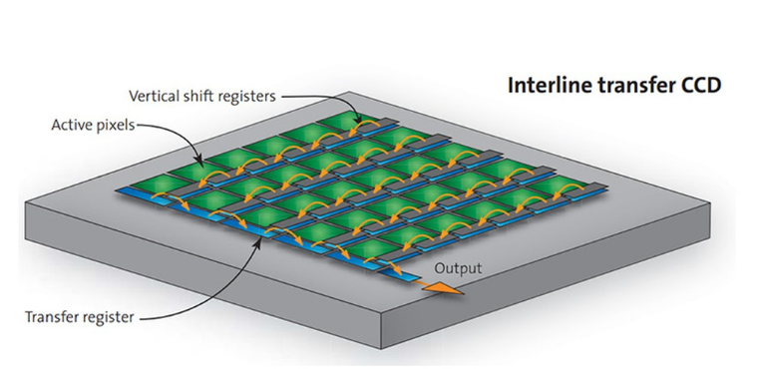

Slide 24
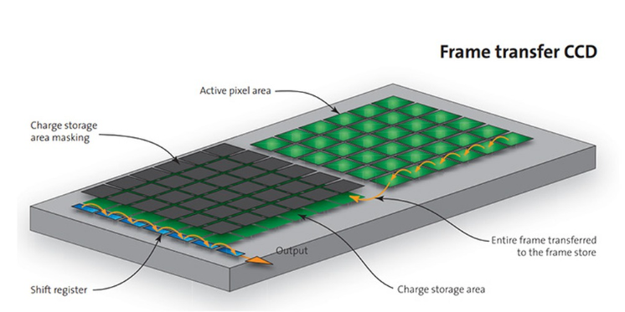

Slide 25
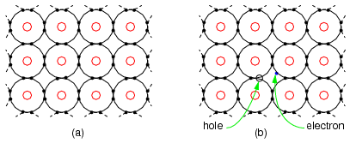
Semiconductors
Inherently poor conductors/good insulators
Full valence shell prevents electron flow in lattice
Must be intrinsically highly pure for semiconductor applications
1 impurity per 10 billion atoms or better

Slide 26
Semiconductors II
Doping: adding a very small amount of “impurities” to change electrical properties
Two main types of doping, p and n
N-doping refers to introducing excess electrons with the impure atoms
P-doping refers to introducing excess holes with the impure atoms
Amount of doping indicated by +,-, or no symbol

Slide 27
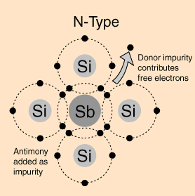
N-doping
Add pentavalent atoms (Group 15) to the tetravalent (Group 14) atoms in semiconductor lattice to contribute extra free electrons
Ex. Antimony added to Silicon lattice

Slide 28
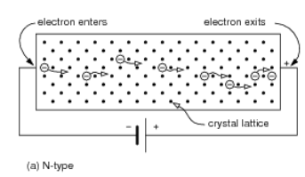
N-type semiconductor
N-type dopants atoms will yield free electrons for conduction, known as “majority carriers”
The electron flow is similar to how electrons flow in an electric wire

Slide 29
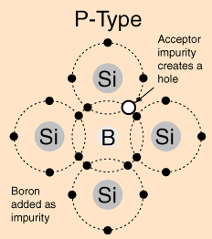
P-doping
Add trivalent atoms (Group 13) to the tetravalent (Group 14) atoms in the semiconductor lattice to contribute extra holes
Ex. Boron added to Silicon lattice

Slide 30
P-type semiconductors
P-type dopant yields regions of localized positive charge known as “holes”
Holes are the majority carrier instead of electrons
The holes “move” in the opposite direction of electron flow

Slide 31
Band Theory
Valence band: outermost electron orbital of an atom which is actually occupied
Conduction band: Farther out than valence band, the level to which electrons can jump to when excited
As the name implies, electrons here have enough energy to move in the material, creates current
The ∆E between the two bands is called “band gap”, which is strongly tied to material conductivity

Slide 32
Critical Thinking Check
Predict the band gap size for semiconductors compared to insulators and conductors.

Slide 33
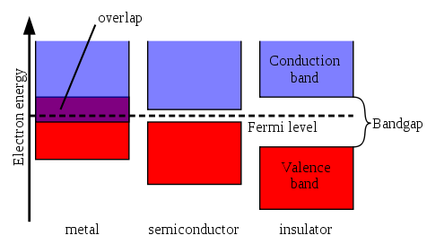
Band Theory II
Insulators have very large band gap
Difficult for electrons to jump to conduction band
Conductors have overlap between conduction and valence band
Electrons can easily move freely through conduction band

Slide 34
Band Theory III
Semiconductors have a narrow band gap
Allows a non-trivial fraction of the valence e’s to move to the conduction band
Conductivity greater than insulators but less than conductors make SCs ideal for electrical circuits
Fermi level: Hypothetical energy level of an electron such that the level has a P = 0.5 of being occupied at any time when thermodynamic equilibrium is present

Slide 35
Output
Pixel clock rate: how quickly the individual pixels are read out from a CCD
Modern computers have CPU clock rate in GHz
CCD clock rate typically given in MHz
Lower bound for imaging speed
Very important for CCD because of the architecture
CMOS each pixel has an amplifier, photoelectrons converted to voltage in parallel
CCD single amplifier for all pixels, one at a time

Slide 36
CMOS vs CCD Benefits
CCD sensors are high-quality, low noise, CMOS is noisier
CCD has higher light sensitivity and QE than CMOS
CCD requires significantly more power than CMOS (up to a hundredfold)
CMOS is much cheaper to produce
CMOS is much faster than CCD
CCD tends have more pixels available

Slide 37
CCD Limitations
Smear: Brighter vertical stripe appearing from a bright part of the image
Can be caused by incident light as the image is being shifted from the sensor to the storage area
Aliasing: Causes interference patterns that inaccurately represent the original signal
Occurs when a signal is sampled at less than twice the highest frequency in a signal
For sound, temporal frequency
For imaging, spatial frequency

Slide 38
CCD Limitations II
Blooming: charge in a pixel exceeds the holding potential of its well
Causes charge to overflow to adjacent pixels
Diffusion: charge generation outside of the depletion region can travel into adjacent cells
Charge Transfer Efficiency: Measure of how well photoelectrons can be shifted from one pixel to the next
Must be VERY high (typically >99.999%)

Slide 39
CCD Limitations III
Quantum efficiency: Number of photoelectrons generated in a pixel per photon striking the photosensitive region
Can vary widely, but CCDs have very good efficiency compared to CMOS and PMT
Dynamic Range: The maximum number of electrons a pixel’s well can hold divided by the read noise (in electrons)

Slide 40
CCD Limitation IV
Noise
Dark current: Electrons accumulate in the pixels even with the absence of light
Generated from thermal excitation, hence why CCDs are typically cooled
Readout noise: Amplifier(s) cannot convert photoelectrons to a voltage perfectly, so uncertainty is introduced
Lower bound on detection limits for faint sources
Shot noise: Caused by discrete nature of electric charge and photons
Variance in the number of packets moved per unit time

Slide 41
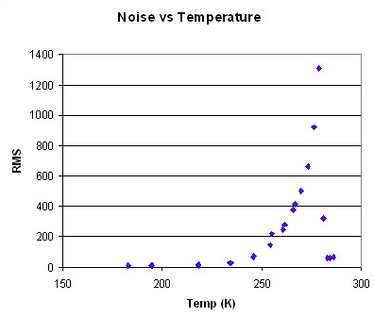
Importance of Cooling
Rule of thumb: Every 6-7 degrees C of cooling will halve the dark current generation

Slide 42

Critical Thinking Check
Shot noise scales with the square root of the signal being collected. If 3600 electrons are detected in a signal, what is the maximum possible SNR the CCD could have?

Slide 43
Glossary
Adatom: an atom which lies on top of a crystal surface, the opposite of a surface vacancy
Clock rate: the frequency at which a chip is running; measured in Hz and indicative of processing speed
PMT: Photomultiplier tube
Bias: establish predetermined voltages/currents at certain points in an electronic circuit
Gain: measure of the ability of a two-port circuit to increase the power of a signal from the input to the output port
RMS: square root of the mean square

